Slide 1
Krister Inde
Low vision teacher since 1971
Author, PhD hc
Project mangager of SMS and CTD

Slide 2
Vision and driving in Scandinavia
Introducing a new field in vision rehabilitation after stroke, glaucoma and diabetes – and low vision

Slide 3
The Role Model of Europe
The Dutch methods are functional and according to the EU Directive
”Access to a Driving License should be
estimated from a profound medical examination in conjunction with a pratical driving test”

Slide 4
Auto & Mobility
ROYAL DUTCH VISIO NL
_ ___ ____ ______ __ __ ___________ _____ __ ______ ___ ____ __ __ ___ ____ ______
Dr Bart Melis Dankers is my inspiration since he claims the same as me
and many others:
”IT IS NOT POSSIBLE TO PREDICT SAFE DRIVING ONLY FROM A MEDICAL EXAMINATION OR VISUAL FEILD ASSESSMENTS WITH HUMPHREY AND ESTERMAN."

Slide 5
Project BTS 2004 - 2007
[Visual Impairment Research, 2008, 10: 1-6]
[Visual Impairment Research, 2008, 10: 7-22]
Inclusion: 0.16 <= BBCVA < 0.5
BTS-programme:
  assessment day
  fitting BTS [optometrist]
  O&M-training 4 x 3 hours [O&M-trainer]
  driving lessons [driving instructor]
  practical fitness to drive test [CBR]
Nystagmus included since 2013
Notes:
AutO-Mobiliteit: Bart Melis-Dankers
Datum 13 september 2010
Pagina 5
visual acuity: 0.16 < BBCVA < 0.5 (20/125 < BBCVA < 20/40)
with telescope VA > 0.5
clear motivation to drive independently
no (additional) restriction of visual field
no neuro-psychological deficits
positive driving screening

Slide 6
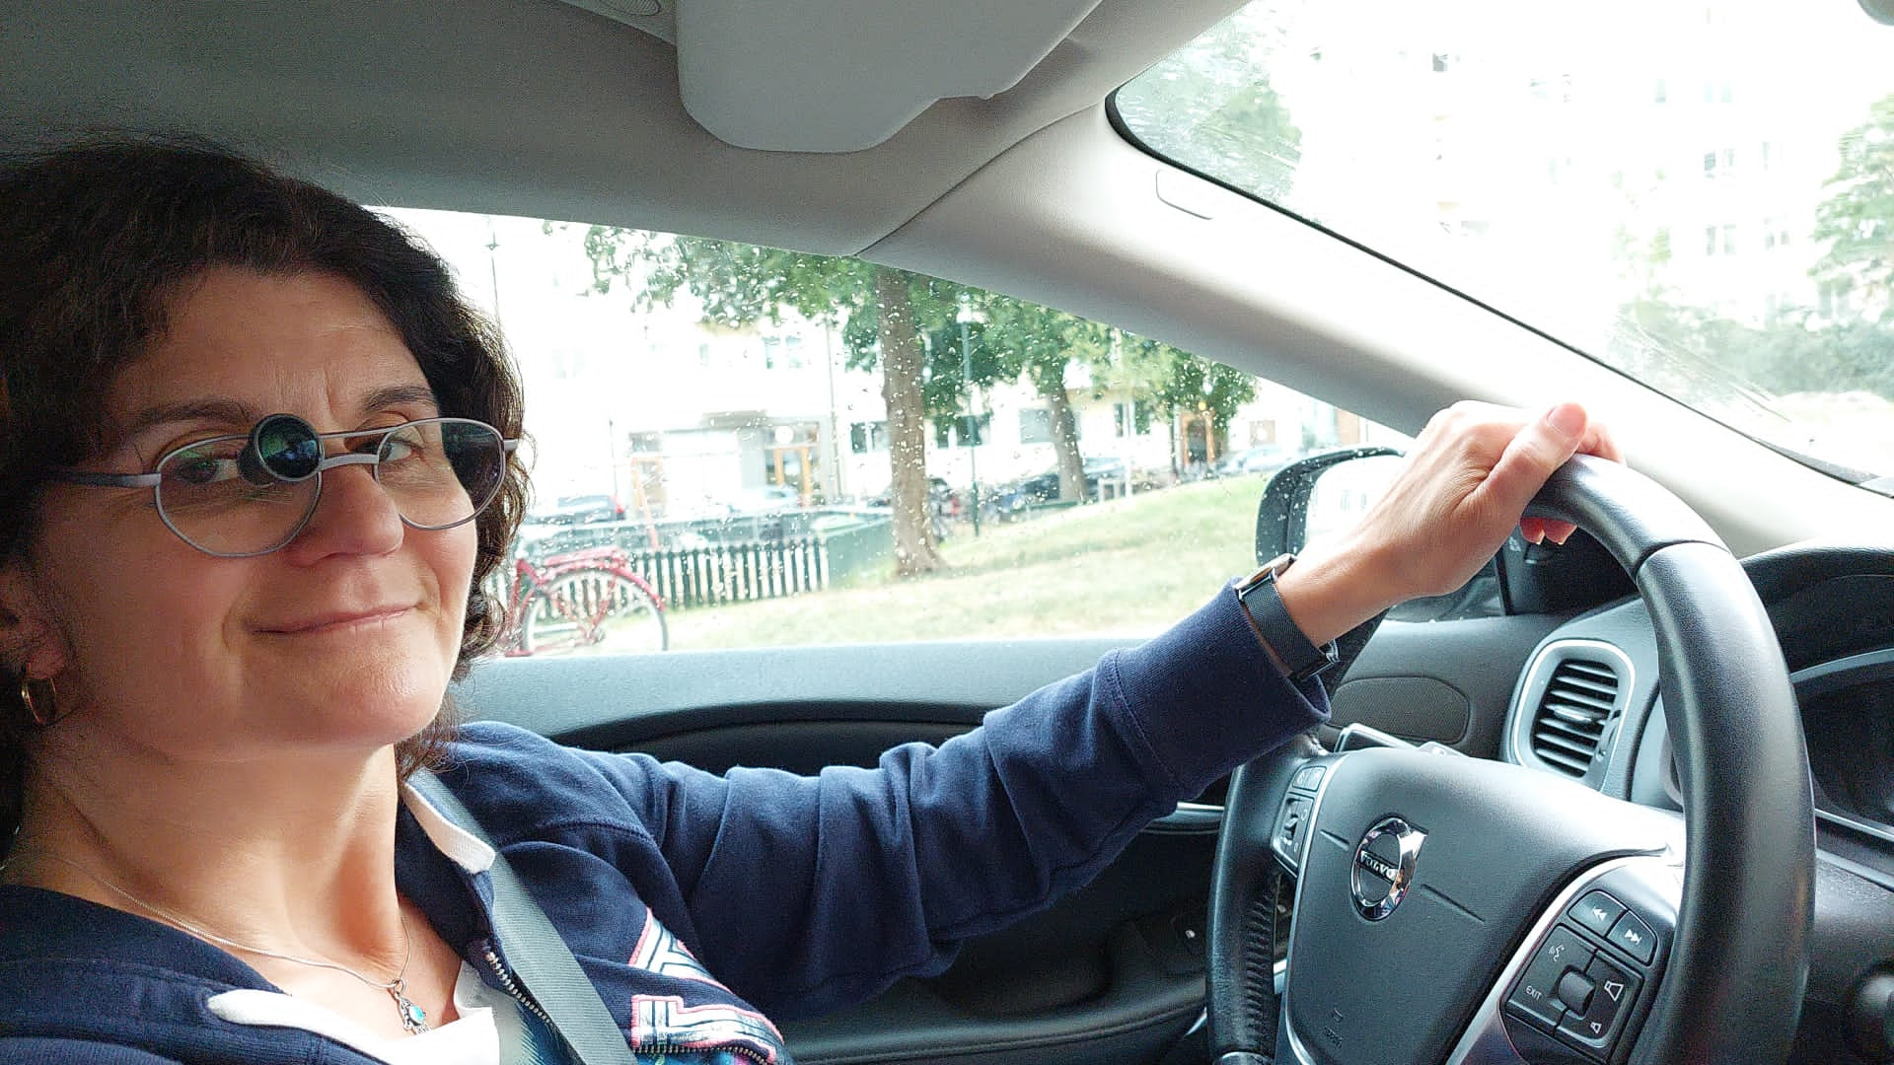

Slide 7
Lobby to change regulations
2007 - 2010
Report to the minister of Transport
Decisions: May 2009 and February 2010
visual acuity impairment:
  VA >= 0.50 : unrestricted driving license
  0.40 <= VA < 0.50 : CBR-test without BTS
  0.16 <= VA < 0.40 : CBR-test with BTS
visual field defect:
  HVF >= 120° : unrestricted driving license
  90°<= HVF < 120 : CBR-test
Notes:
AutO-Mobiliteit: Bart Melis-Dankers
Datum 13 september 2010
Pagina 7

Slide 8
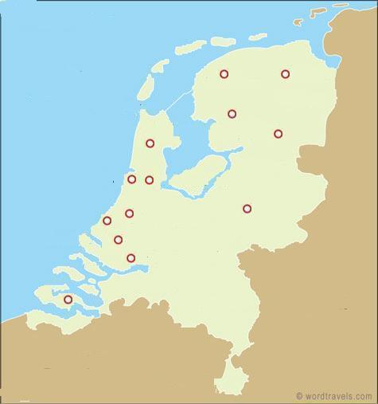
Extending consortium 2009 - 2010
4 regions
12 locations education of:
  9 information officers
  31 optometrists
  32 O&M trainers
  6 clinical physicists
  5 neuro-psychologists
  23 driving instructors
  8 CBR experts on practical
  fitness to drive
  12 CBR driving examiners
September 2010: Auto-Mobility nationally available
North
W
SW
°
South
°
Notes:
AutO-Mobiliteit: Bart Melis-Dankers
Datum 13 september 2010
Pagina 8
8
fusie Visio-Sensis per 1 januari 2010
Utrecht: naar keuze

Slide 9
SMS and CTD in Kalmar 2013-220
A team of Professionals from different areas:
Eye doctors
Optometrists
Driving instructors
VTI researchers
OT, LVT
Financed by Sweidsh Heritage Fund

Slide 11
Lobbying to Parliament and Minister of Transport
June 10, 2020 Parliament:Yes, We have to change
September, 2021 Government: Yes – we need driving tests on road and in simulators
September, 22, 2022: Sweidsh Transport Agency presents their new regulations….will be interesting

Slide 12
TWO PIONEERS!
In Sweden driving licenses are being revoked only from visual field examinations using Humphrey and/or Esterman tests. Two Swedish persons Helene and Magnus with low vision and visual field defects have legal Swedish driving licenses! How come?

Slide 13
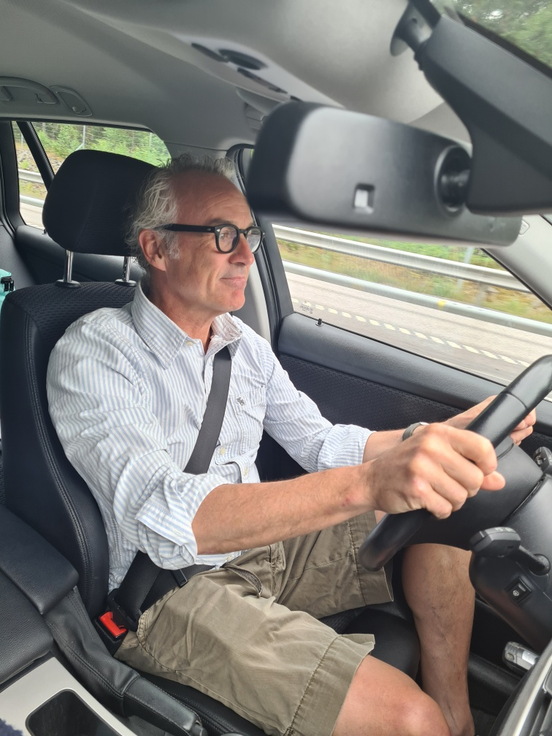
MAGNUS FORSLUND
Magnus Forslund got an exceptional license with VFD – Homonym Quadrantanopia up to the right
Extremely good scanning ability in with VISIOcoach in CTD
Perfect drvining tests in simulator CTD
Splendid driving test on road (Golden Standard) in the Netherlands
40 years as a flying pilot.- now flight scurity officer with Transportstyrelsen
It took four years of fight!

Slide 14
HELENE BLAD
Low vision BCVA 0,2/0,3
Driving lessons in NL as a residence
Dutch driving license with BTSa
Now Swedish driving license with BTS code in daylight
Applies for BTS license all day
Medical doctor Stockholm

Slide 15
September, 22 2022
First presentation of new rules replacing TSFS 2010:125 will be presented to the patient orgainsations
He or she who lives will see…

